Slide 1


Cross-sectional Prediction of Diabetic Foot Ulcer Using Machine Learning in Diabetic Patients with EHR from Canadian Primary Care Clinics
Team #1
Chieh En Chen
Owusu Boakye Gideon
Jessie Tian
HAD5016- APPLIED MACHINE LEARNING FOR HEALTH DATA
Winter 2026
University of Toronto
Notes:
- Do not alter the font size and color of the text components.
- Add your team number and the names of your team members to the assigned text box without making changes to the font and formatting.
- Please do not add extra details to the cover page.
- Ensure that the entire presentation does not exceed three minutes.
- Suggestion: Allocate 10 seconds to this slide.

Slide 2
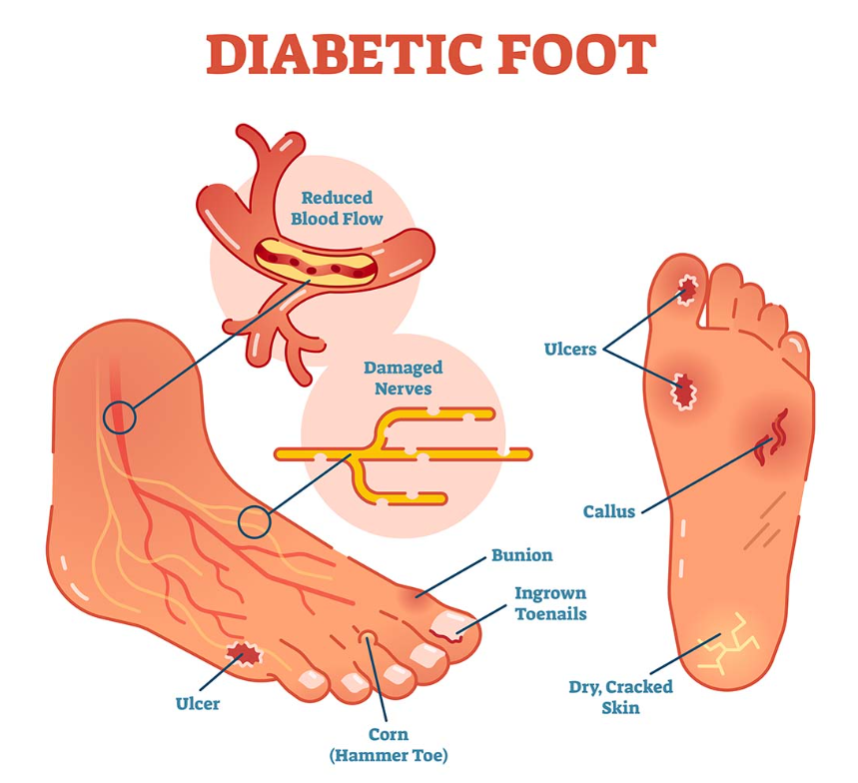
Background
Diabetic foot ulcer (DFU) - complication of diabetes
Global prevalence - 6.4% in type 2 diabetes patients ^{[1]}
20% of moderate or severe diabetic foot infections lead to amputation ^{[2]}
Early identification of high-risk patients is crucial
Poor glycemic control (HbA1c, fasting blood sugar) ^{[3]}
Prolong duration of DM meds and second-line ^{[4]}
Long-term corticosteroids use hampers wound healing and exacerbates hyperglycemia ^{[5,6]}
Stegge et al. ^{[7]} - age, history of neuropathy and lesion ->regression model with AUC = 0.69
Gap in use of DM meds and corticosteroid to predict DFU
Figure 1: Illustration of diabetic foot and its cause.
Image credit: Diabetic Foot Ulcers treated at SCMSC in Los Angeles
Notes:
Reference:
1. Zhang P, Lu J, Jing Y, Tang S, Zhu D, Bi Y. Global epidemiology of diabetic foot ulceration: a systematic review and meta-analysis. Ann Med. 2017;49: 106–116. doi:10.1080/07853890.2016.1231932
2. Armstrong DG, Boulton AJM, Bus SA. Diabetic Foot Ulcers and Their Recurrence. Ingelfinger JR, editor. N Engl J Med. 2017;376: 2367–2375. doi:10.1056/NEJMra1615439
3. Boyko EJ, Ahroni JH, Stensel V, Forsberg RC, Davignon DR, Smith DG. A prospective study of risk factors for diabetic foot ulcer. The Seattle Diabetic Foot Study. Diabetes Care. 1999;22: 1036–1042. doi:10.2337/diacare.22.7.1036
4. Fonseca VA. Defining and characterizing the progression of type 2 diabetes. Diabetes Care. 2009;32 Suppl 2: S151-156. doi:10.2337/dc09-S301
5. Saboo B, Joshi S, Gupta A, Maheshwari A, Saboo B, Makkar BM, et al. Responsible Use of Oral Corticosteroids in People with Comorbid Diabetes: An Expert Consensus. J Assoc Physicians India. 2024;72: 79–93. doi:10.59556/japi.72.0573
6. Singer B, Chaimovitz D, Bucek T, Dayon E, Abbott-Korumi A, Spatz M, et al. Corticosteroid Use in Musculoskeletal and Neuraxial Interventions: Effects on Glycemic Control. Medicina (Mex). 2025;61: 936. doi:10.3390/medicina61050936
7. Stegge WB aan de, Schut MC, Abu-Hanna A, Baal JG van, Netten JJ van, Bus SA. Development of a prediction model for foot ulcer recurrence in people with diabetes using easy-to-obtain clinical variables. BMJ Open Diabetes Res Care. 2021;9. doi:10.1136/bmjdrc-2021-002257

Slide 3

Objectives
To predict occurrence of DFU using routine glycemic indicators and cumulative medication history in diabetic patients
Research questions
Can a combination of routine glycemic indicators (HbA1c, FBS) and cumulative medication histories (duration of corticosteroids and antidiabetic agents) predict the occurrence of diabetic foot ulcers?
Model performance difference between logistic regression, Gaussian Naïve Bayes (GNB), XGBoost
Canadian Primary Care Sentinel Surveillance Network (CPCSSN) - chronic disease EHR from primary care clinics
1990 to 2015
808,921 rows in total
234,464 DM
203,167
missing DFU outcome
31,297
DFU records
31,167 no DFU
(99.6%)
130 had DFU (0.4%)

Slide 4
Methodology
ML models and methods selected for handling binary target variable classification class and high class imbalance
Logistic regression: Easy interpretability
GNB: Less training data required (assume independent attributes), quickest/least computationally intense
XGBoost: built-in regularization ensemble method
Preprocessing
Training/testing split: stratify and group by patient ID to ensure positive DFU cases presence in both sets
Multiple Imputations (MICE) to address MAR for HbA1c on separate training/test
Hyperparameter tuning using GridSearch with stratified K-fold cross-validation (k=5)
Logistic: “balanced” class weight vs no weights
GNB: range of smoothing parameter to balance variance and bias trade-off
L2 regularization
Resampling techniques: undersampling majority, oversampling minority, combined
Recall optimization metric
Notes:
- Provide an overview of the Methods section in this slide, including the ML models employed and the rationale for their selection.
- Maintain the slide's title and template as provided.
- Suggestion: Allocate around 40 seconds to this slide.

Slide 5
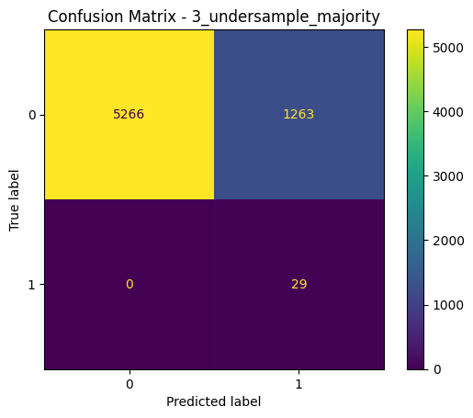
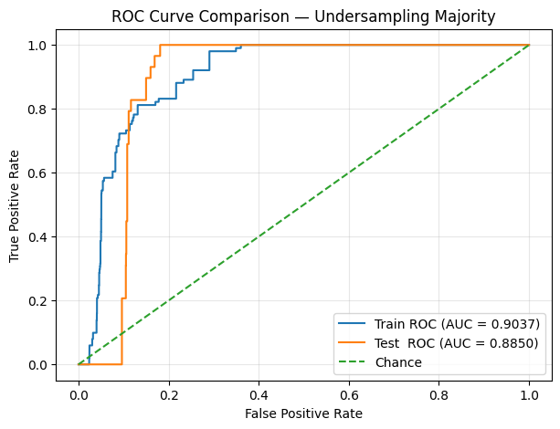
Results
Best performing model: Logistic regression with undersampling majority (weighted recall: 0.807; macro avg recall: 0.903)
Positive DFU class: perfect recall (1.00) mean model correctly predicted 29/29 outcomes in test set; high rate of false positives (precision = 0.022)
Logistic regression less prone to bias from extreme class imbalance compared to XGBoost and GNB is conditional on feature independence
Figure 2: Confusion matrix of best logistic regression model.
Figure 3: ROC-AUC curves of training and testing sets of best logistic regression model.
Notes:
- Summarize the primary outcomes of your work.
- Present the content with a technical focus, yet in a way that is easily understood by non-technical attendees.
- Suggestion: Dedicate 45-60 seconds to this slide.

Slide 6
Takeaways
Logistic regression model outperformed GNB and XGBoost at binary DFU classification task
Demonstrated how cumulative medication history and glycemic biomarkers might be used as clinically meaningful predictors for DFU
Cross-sectional treatment of data risk label leakage
Low positive outcome class causes high variance limited generalizability
 | Recall (weighted avg) | Recall for positive DFU cases
Logistic regression | 0.807 | 1.0
GNB | 0.708 | 1.0
XGBoot | 0.994 | 0.0
Table 4: Model Performance (Recall).
Notes:
- Please do not change the text formatting.
- Choose a concise and informative title for this slide, as it serves as the conclusion of your presentation.
- Suggestion: Allocate 30-45 seconds for this slide.

Slide 7
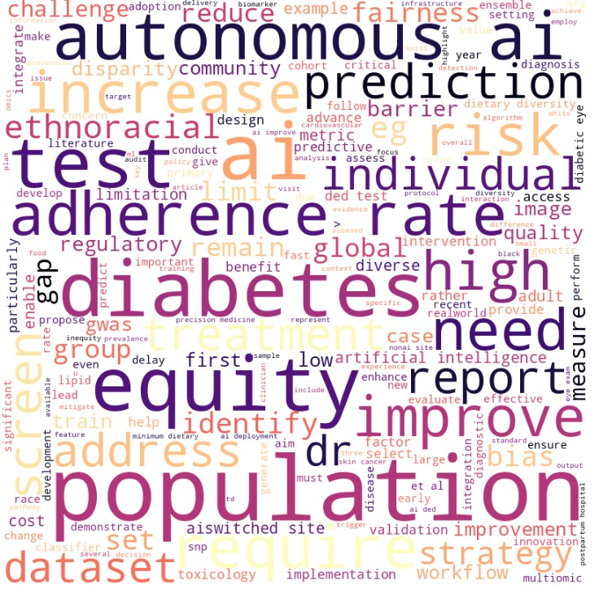
Beyond Prediction - Leveraging AI and Equity in Workflows
Pubmed search on March 20,2026
22 selected papers (14 DM/DFU-specific)
NLP Pipeline
Text processing - combine, convert to lower case, remove special characters
Tokenization & remove stop words
Lemmatization
Interpretation
Risk of ethnoracial bias and disparity gap
Deploy autonomous AI to increase test adherence
Evaluate equity as a workflow metric
Figure 5: Word Cloud Results
Notes:
- Please do not change the text formatting.
- Choose a concise and informative title for this slide, as it serves as the conclusion of your presentation.
- Suggestion: Allocate 30-45 seconds for this slide.

